Slide 1
Web Project

Slide 2
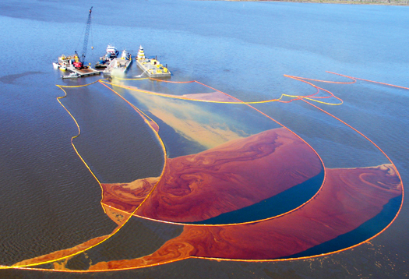
Oil Spills

Slide 3
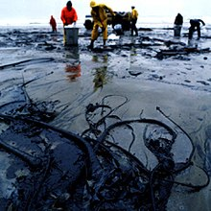
What are Oil Spills?
Spill;
Can be terrestrial or aquatic;
Can be Natural or Anthropogenic;

Slide 4
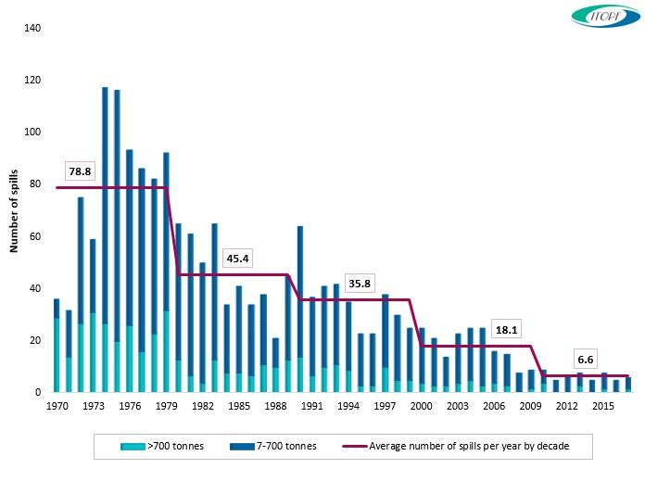
How frequent are they?
http://www.itopf.com/knowledge-resources/data-statistics/statistics/

Slide 5
The Danger of Oil Spills
Consequences to the Environment;
Affects our Society;
Cleaning is not 100% effective;

Slide 6
What is being done about this problem?
Awareness;
Green Commitments / Programs and Projects;
Cleaning Technology and Companies;

Slide 7
Why are we doing this?
The Danger of the Problem;
Raise Awareness.

Slide 8

Proposed Solution

Slide 9
H2Oil-Project

Slide 10
What is H2Oil-Project?
Online Community;
Oil Spills and Black Tides;
Share Experiences;
Report Suspicious Sightings.

Slide 11

Website Features
Create and Share Posts;
Share Media;
Companies Tab;
News Feed;
Interactive Map;
Report Possible Spills.

Slide 12
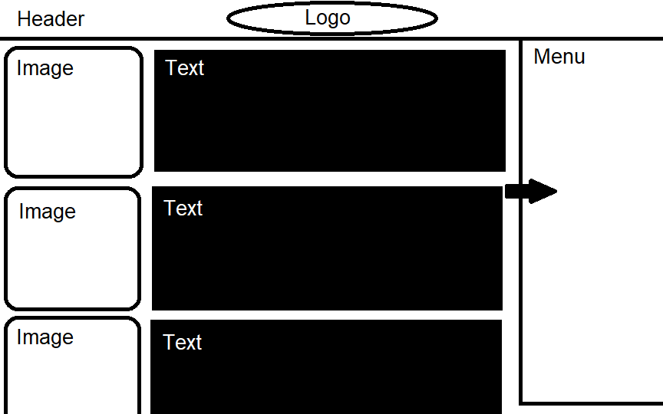
Design of the Website

Slide 13
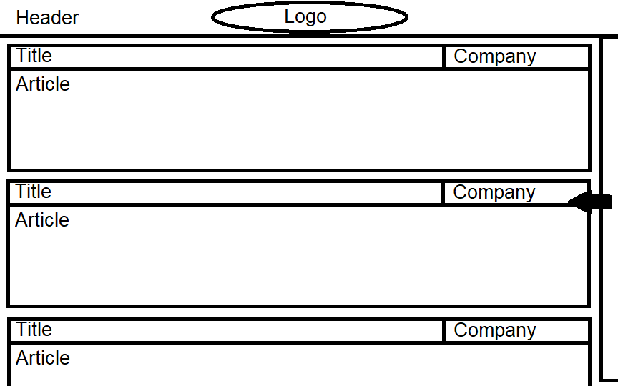
Design of the Website

Slide 14

Q&A

